Slide 1

Lending Club Case Study
Ojus Jaiswal
Nishant Sonuley

Slide 2
Lending Club Case Study
Agenda of this case study was to analyze customer loan data using Python
Data set was shared in csv format
Team cleaned the data, added comments wherever necessary and created reusable code modules to plot graphs for important loan and customer attributes (parameters).
In this presentation, we have used univariate analysis, segmented univariate analysis and bivariate analysis
We have also identified metrics of given attributes (parameters) as type driven, data driven or business driven.

Slide 3
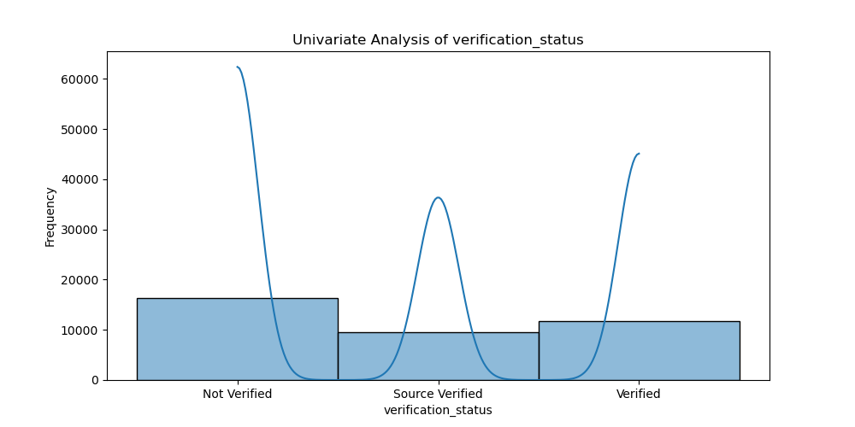
Univariate Analysis of verification_status
This slide presents the univariate analysis of verification_status.
Conclusion: Verification status provides useful insights but alone is not sufficient for loan approval.
Metric: Type-Driven Metric

Slide 4
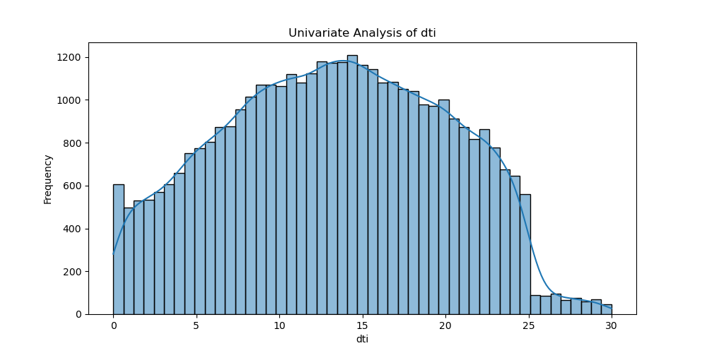
Univariate Analysis of dti
This slide presents the univariate analysis of dti.
Conclusion: DTI can be used to decide loan approval as it affects financial stability.
Metric: Data-Driven Metric

Slide 5
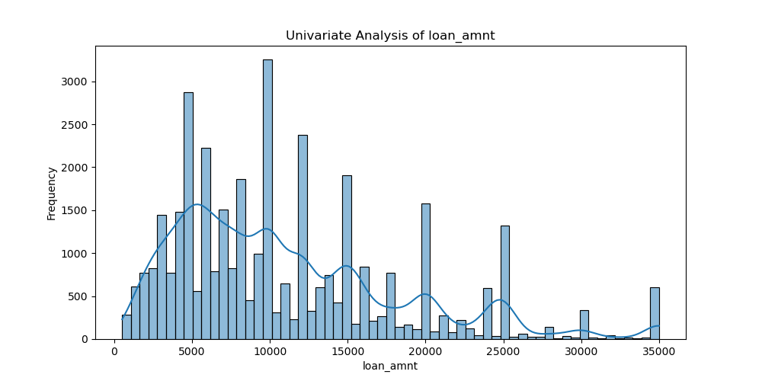
Univariate Analysis of loan_amnt
This slide presents the univariate analysis of loan_amnt.
Conclusion: Loan amount can be used to decide loan approval as it indicates borrowing needs.
Metric: Data-Driven Metric

Slide 6
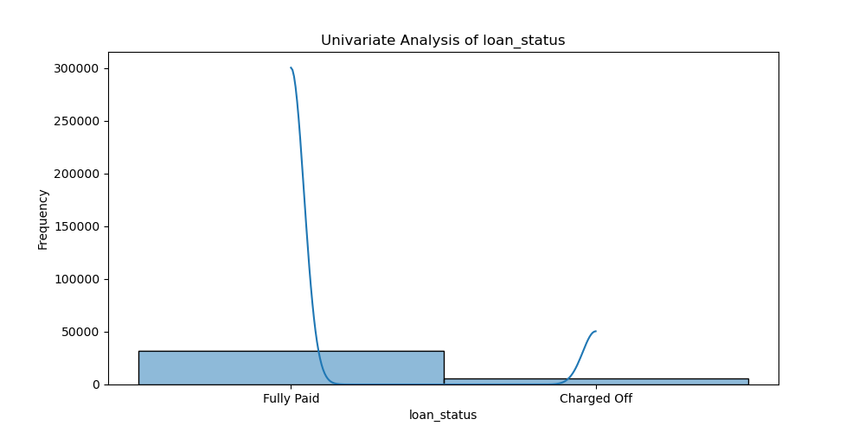
Univariate Analysis of loan_status
This slide presents the univariate analysis of loan_status.
Conclusion: Loan status provides useful insights but alone is not sufficient for loan approval.
Metric: Type-Driven Metric

Slide 7
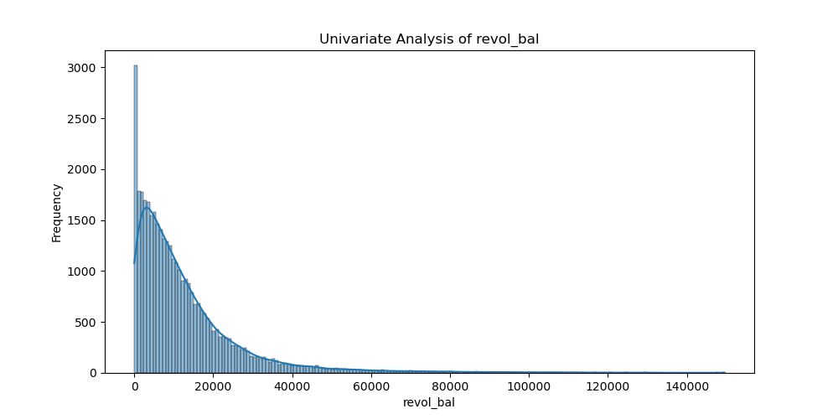
Univariate Analysis of revol_bal
This slide presents the univariate analysis of revol_bal.
Conclusion: Revolving balance can be used to decide loan approval as it shows existing debt.
Metric: Data-Driven Metric

Slide 8
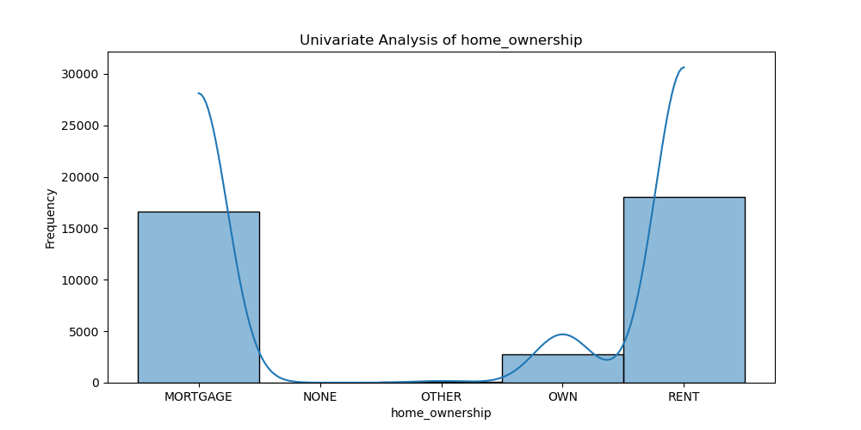
Univariate Analysis of home_ownership
This slide presents the univariate analysis of home_ownership.
Conclusion: Home ownership provides useful insights but alone is not sufficient for loan approval.
Metric: Type-Driven Metric

Slide 9
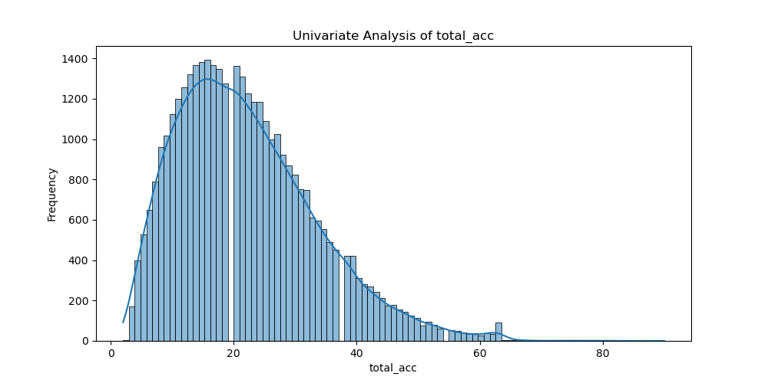
Univariate Analysis of total_acc
This slide presents the univariate analysis of total_acc.
Conclusion: Total accounts can be used to decide loan approval as it reflects credit history.
Metric: Data-Driven Metric

Slide 10
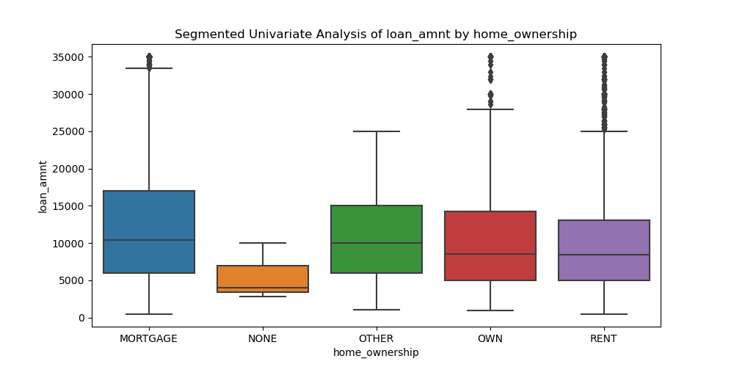
Segmented Univariate Analysis of loan_amnt by home_ownership
This slide presents the segmented univariate analysis of loan_amnt by home_ownership.
Conclusion: Loan amount segmented by home ownership provides insights into loan approval criteria.
Metric: Data-Driven Metric

Slide 11
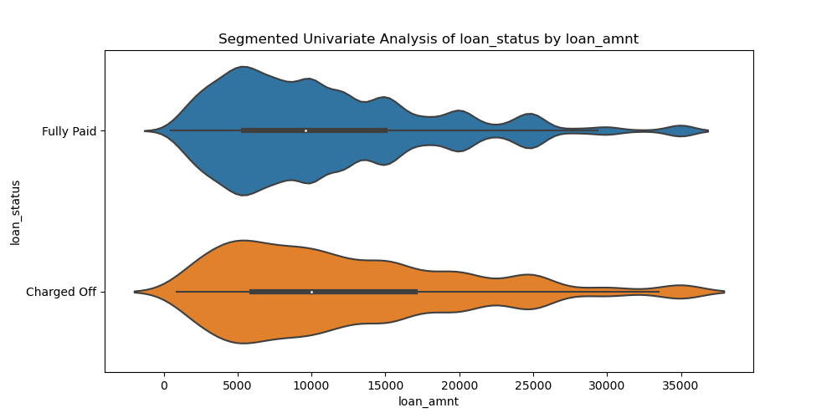
Segmented Univariate Analysis of loan_status by loan_amnt
This slide presents the segmented univariate analysis of loan_status by loan_amnt.
Conclusion: Loan status segmented by loan amount provides insights into loan approval criteria.
Metric: Data-Driven Metric

Slide 12
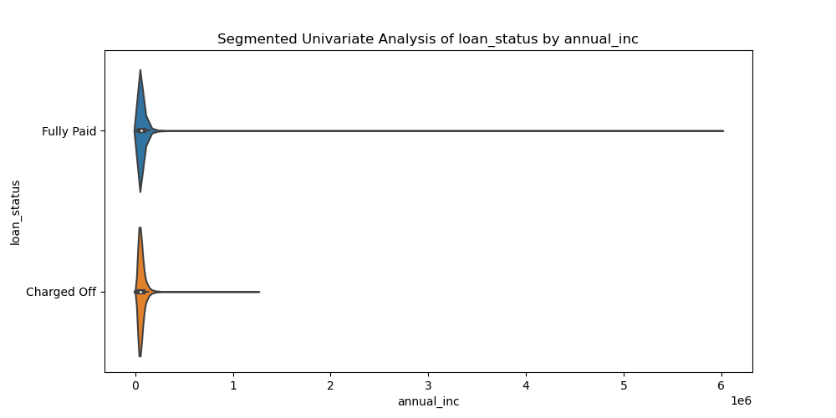
Segmented Univariate Analysis of loan_status by annual_inc
This slide presents the segmented univariate analysis of loan_status by annual_inc.
Conclusion: Loan status segmented by annual income provides insights into loan approval criteria.
Metric: Data-Driven Metric

Slide 13
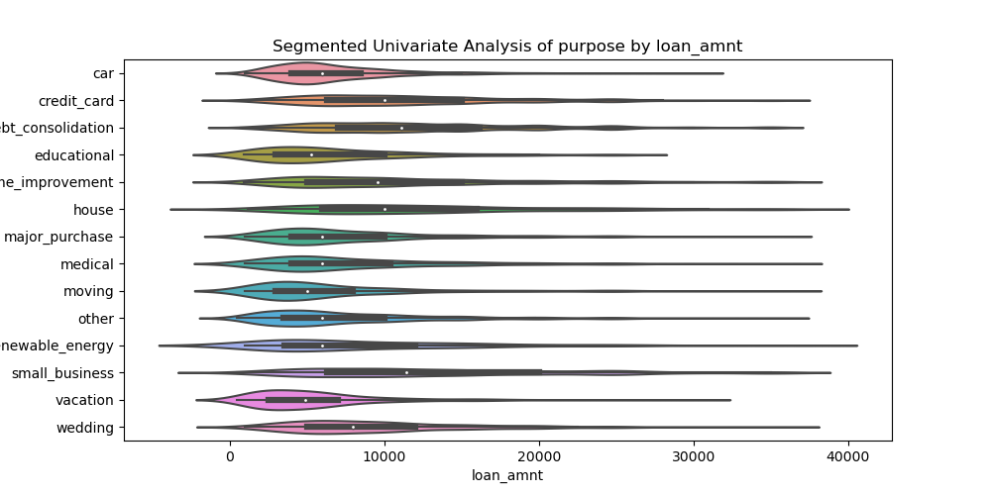
Segmented Univariate Analysis of purpose by loan_amnt
This slide presents the segmented univariate analysis of purpose by loan_amnt.
Conclusion: Loan purpose segmented by loan amount provides insights into loan approval criteria.
Metric: Data-Driven Metric

Slide 14
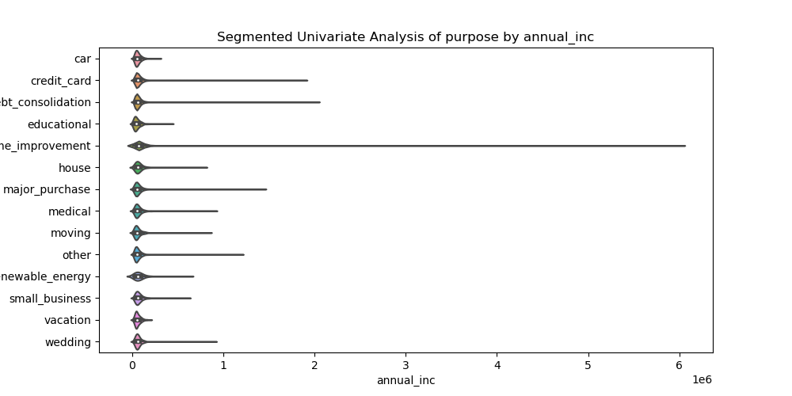
Segmented Univariate Analysis of purpose by annual_inc
This slide presents the segmented univariate analysis of purpose by annual_inc.
Conclusion: Loan purpose segmented by annual income provides insights into loan approval criteria.
Metric: Data-Driven Metric

Slide 15
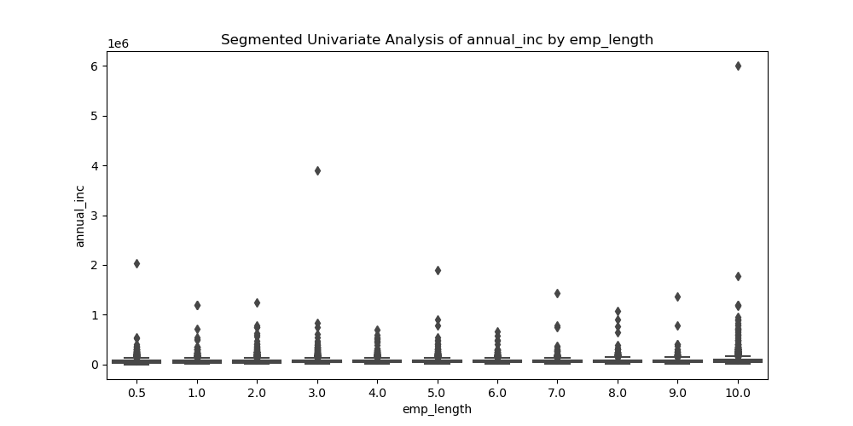
Segmented Univariate Analysis of annual_inc by emp_length
This slide presents the segmented univariate analysis of annual_inc by emp_length.
Conclusion: Annual income segmented by employment length provides insights into loan approval criteria.
Metric: Data-Driven Metric

Slide 16
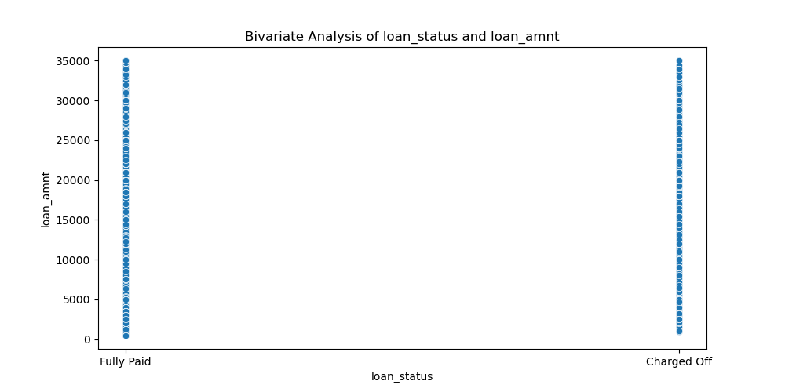
Bivariate Analysis of loan_status and loan_amnt
This slide presents the bivariate analysis of loan_status and loan_amnt.
Conclusion: The relationship between loan status and loan amount can guide loan approval decisions.
Metric: Business-Driven Metric

Slide 17
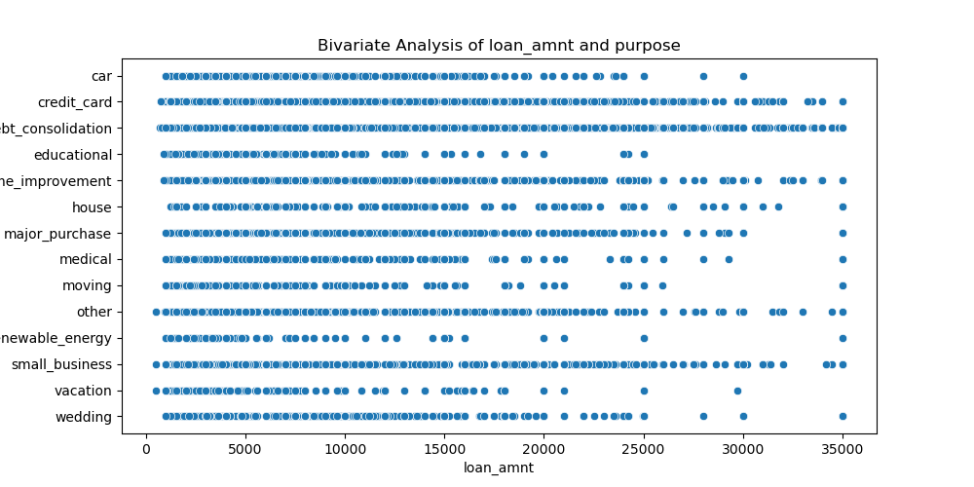
Bivariate Analysis of loan_amnt and purpose
This slide presents the bivariate analysis of loan_amnt and purpose.
Conclusion: The relationship between loan amount and purpose provides useful insights but is not definitive for loan approval.
Metric: Type-Driven Metric

Slide 18
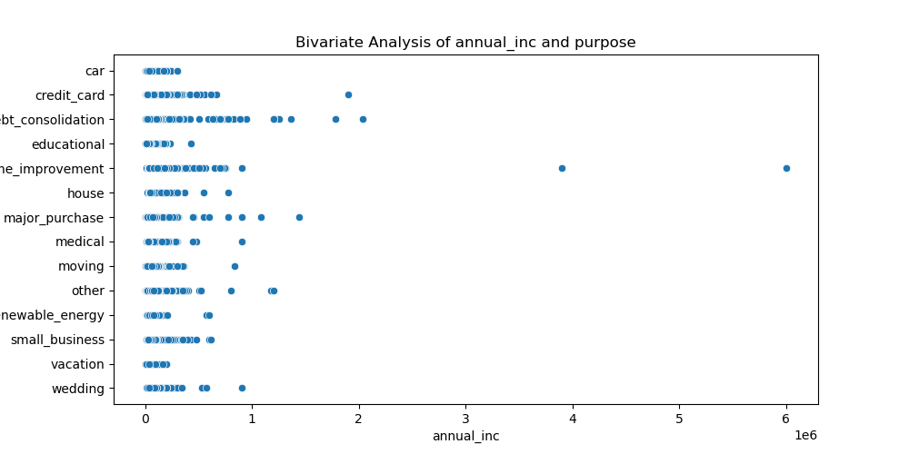
Bivariate Analysis of annual_inc and purpose
This slide presents the bivariate analysis of annual_inc and purpose.
Conclusion: The relationship between annual income and purpose provides useful insights but is not definitive for loan approval.
Metric: Type-Driven Metric

Slide 19
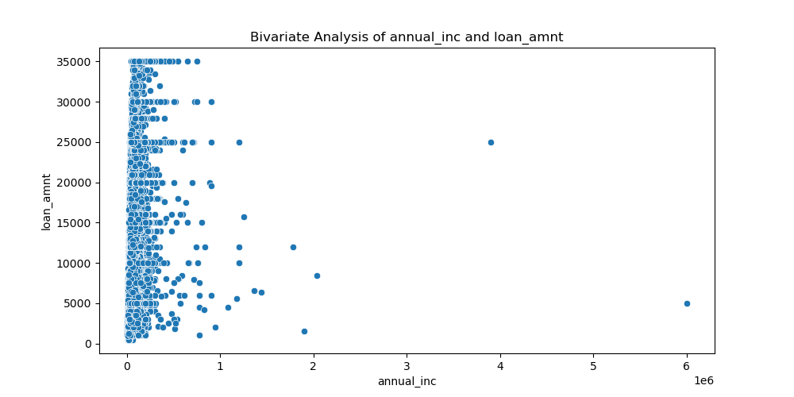
Bivariate Analysis of annual_inc and loan_amnt
This slide presents the bivariate analysis of annual_inc and loan_amnt.
Conclusion: The relationship between annual income and loan amount can guide loan approval decisions.
Metric: Business-Driven Metric

Slide 20
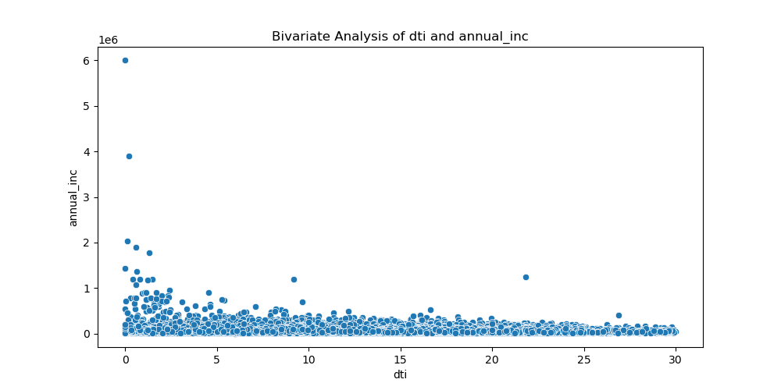
Bivariate Analysis of dti and annual_inc
This slide presents the bivariate analysis of dti and annual_inc.
Conclusion: The relationship between DTI and annual income can guide loan approval decisions.
Metric: Business-Driven Metric

Slide 21
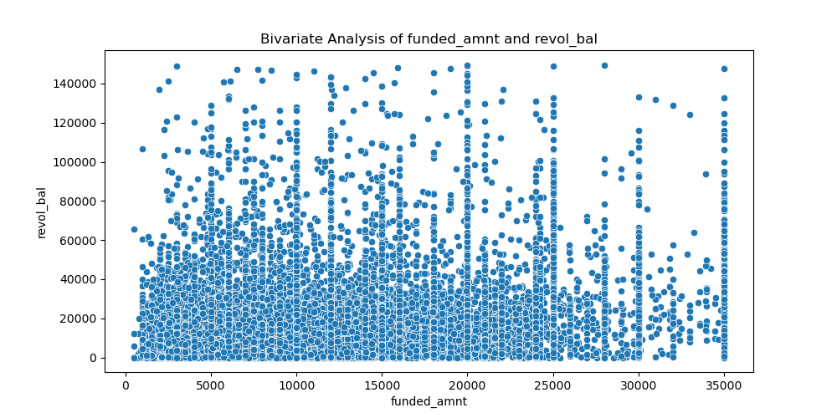
Bivariate Analysis of funded_amnt and revol_bal
This slide presents the bivariate analysis of funded_amnt and revol_bal.
Conclusion: The relationship between funded amount and revolving balance provides useful insights but is not definitive for loan approval.
Metric: Type-Driven Metric

Slide 22
Conclusion
We have observed each graph and patterns
We have collected insight based on each graph and derived conclusion against each attribute used for analysis
Type driven metrics alone are not useful and not definitive in identifying if loan can be risky or not
Data driven and business driven metrics work best when coupled with other attributes

Slide 23
Thank you
References:
1. Dataset and dictionary provided in case study
2. EDA Module

